Slide 1

aiml internship
HENOTIC TECHNOLOGY PRIVATE LIMITED
7th July 2022 to 06th September 2022
Presented by:
Y. Sathwika
¾ CSBS
RegdNo: 20B91A5764
DEPARTMENT OF INFORMATION TECHNOLOGY ,SRKREC

Slide 2
Data set name:
EMPLOYEE PROMOTION PREDICTION

Slide 3
Contents:
INTRODUCTION ABOUT DATASET
OBJECTIVE
DATA SCIENCE PROJECT LIFE CYCLE
RESULTS
RECOMMENDATIONS AND CONCLUSIONS
REFERENCES

Slide 4
INTRODUCTION ABOUT DATASET
Employee Promotion means the ascension of an employee to higher ranks. It involves an increase in salary, position, responsibilities, status, and benefits. Employee Promotion plays a big role in Employee Satisfaction. It aids in employee engagement, boosts morale, reduces absenteeism, and ultimately in productivity.
the purpose of any performance review is to be sure employees know how they can develop their talents and energies and use them more effectively to contribute to the organization's success.
We split the dataset into two sets:
Test set contain 13 columns and 23000 rows approximately.
Train set contain 14 columns and 54000 rows approximately

Slide 5
OBJECTIVE
Explore and visualize the dataset.
Build a classification model to predict if the customer has a higher probability of getting a promotion
Optimize the model using appropriate techniques
Generate a set of insights and recommendations that will help the company
Predicting whether an employee is promoted or not based on various factors
The aim is to analyze the various factors that can contribute to the promotion of an employee. Based on the analysis, predict which employees will be promoted.

Slide 6
The following are various Attributes:
employee_id: Unique ID for the employee
department: Department of employee
region: Region of employment (unordered)
education: Education Level
gender: Gender of Employee
recruitment_channel: Channel of recruitment for employee
no_ of_ trainings: no of other trainings completed in the previous year on soft skills, technical skills, etc.
age: Age of Employee
previous_ year_ rating: Employee Rating for the previous year
KPIs met(1 if >80%)-total KPIs met in the tenure
length_ of_ service: Length of service in years
awards_ won: if awards won during the previous year then 1 else 0
avg_ training_ score: Average score in current training evaluations
is_promoted: (Target) Recommended for promotion

Slide 7
Data Science Project Life Cycle
Data Pre-processing
Check the Duplicate and low variation data
Identify and address the missing variables
Handling of Outliers
Categorical data and Encoding Techniques
Feature Scaling
Selection of Dependent and Independent variable
In my dataset, target variable is is_promoted
Training Models

Slide 8
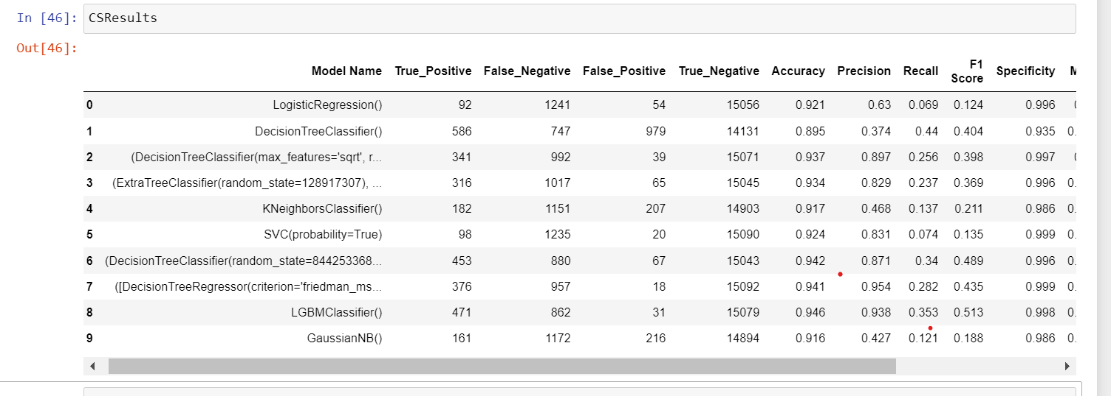
RESULTS
Based on the analysis , these are the results generated from different models

Slide 9
RESULTS
The model results in the following order by considering the model accuracy, F1
score and RoC AUC score.
LGBM Classifier with Stratified and Random Sampling
Decision tree classifier with Stratified and Random Sampling
Decision tree Regressor with Simple Random Sampling
We recommend model – LGBM Classifier with Stratified Sampling technique as a
best fit for the give n BI claims dataset. We considered LGBM Classifier because it
uses bootstrap aggregation which can reduce bias and variance in the data and can
leads to good predictions with employee promotion prediction database.

Slide 10
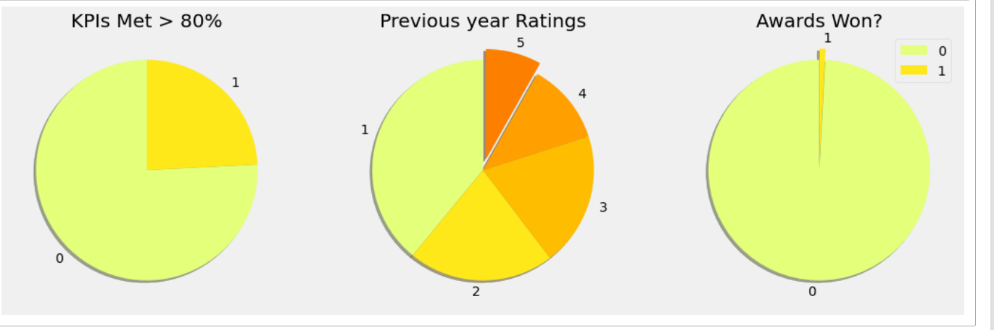
RECOMMENDATIONS AND CONCLUSIONS
Pie chart for the columns where we have very few categories

Slide 11
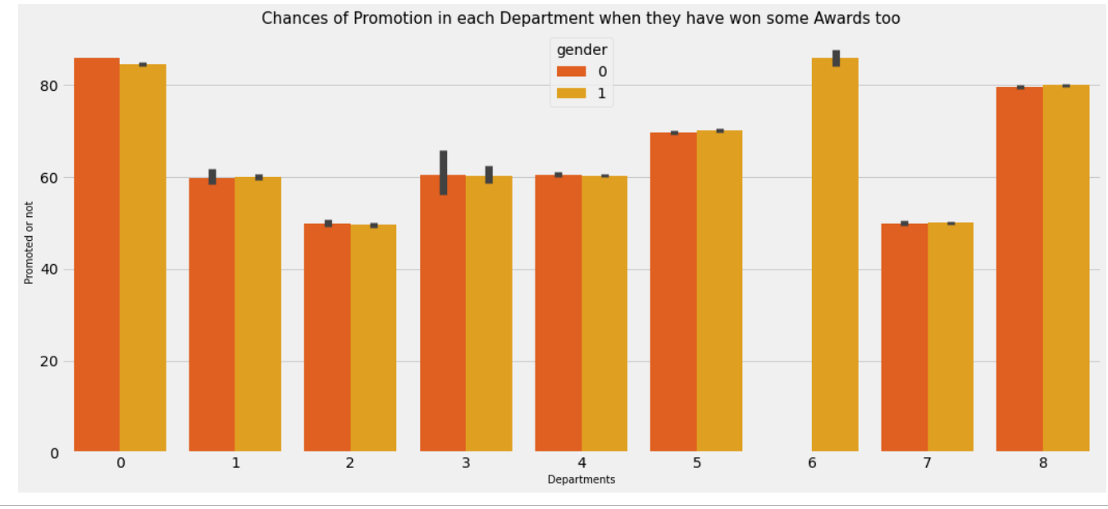
RECOMMENDATIONS AND CONCLUSIONS
The relation of Departments and Promotion when they won awards

Slide 12
References
The dataset has taken from Kaggle and the link
https://www.kaggle.com/datasets/ifeanyichukwunwobodo/employee-promotion-
prediction
Information gathered from
https://www.simplilearn.com/10-algorithms-machine-learning-engineers
need-to-know-article
https://cdn.dataisgood.com/wp-content/uploads/2020/10/12225729/Employee-
Promotion-Prediction.pdf

Slide 13
THANK YOU

